Slide 1

Open Source at Enterprise Scale
Jeremy Justus, Ross Sbriscia
Optum Technology
Notes:
R
There is no Open Source without a Community.

Slide 2

Jeremy Justus Sr Software Engineer
Seeker of Stack Overflows
Kong Champion
Ross Sbriscia Sr Software Engineer
Expert Googler Kong Champion
Notes:
S
Need new pictures!

Slide 3

Healthcare Space 300,000 Employees Thousands of APIs Fortune Six Company
Optum Technology
Optum provides the tech infrastructure for UnitedHealth Group
Notes:
R
OPTUM LEGAL – PHOTO SOURCE: https://www.unitedhealthgroup.com/newsroom/media-library.html
So, what's Optum?
Optum is a large healthcare services and technology company. It's part of UnitedHealthgroup, and one of it's important responsibilities is to provide much of the tech infra for this Forture 6 healthcare giant. And you can see it on the screen, just for a sense of scale, 300k employees, thousands of APIs, countless integrations with varius systems, internally and externally. There's a lot a going on.

Slide 4
Starting Point
Closed-Source Gateway Solution
Primary Gateway Solution for 3 years
Stability Issues
Scalability/Performance Issues
Low Supportability
High Operating Costs
API Gateway Space, Late 2017
The Gateway Solution
Notes:
R
https://pixabay.com/photos/analytics-charts-traffic-marketing-925379/
…
So let's focus in on one particular space, and start talking about API Gateways.
[blah]
Low Supportability – Difficult and near impossible in some cases to create effective integrations with the solution – to do things like, enable devops
High Operating Costs – which in this case means 3 things. 1 – the product itself was pricey, 2 – it was so resource intensive that it took a lot of infra to run, and third, due largely to the supportability issue – it required a very large operations team to maintain
Needless to say, we were interested in replacing the solution – but before I go there, I want to briefly address an important point that really shouldn’t go unsaid.

Slide 5

Optum’s Modernization Movement
Invest in Open Source!
An organizational change in mindset, as both a top-down and bottom-up initiative.
Supported By
Engineers
Architects
Legal
Security
Sr. Executives
Notes:
R
At that same time as we were coming to this realization over in the Gateway space, there was a larger movement going on throughout the enterprise regarding opensource.
[ thing I shouldn’t say ]
But that was changing. There were voices from all across the enterprise, including and crucially, people in positions of power and influence saying “Hey, what could really do with these Opensource solutions if we started to really invest in this, and create processis which support this? What’s possible?”
And as a result of that movement, we ended up with selection criteria for a new gateway along these lines.

Slide 6


Gateway Selection Criteria
Open Source vs Proprietary
Extensibility
Avoid vendor lock
Licensing management/cost
Stateless vs Stateful
Ease of scale and replication
Automated build and deployments
Decreased recovery time
Federated DevOps model
Performance
Asynchronous routing
Resource efficiency
Higher throughput
Notes:
R
https://www.geograph.ie/photo/5107100
https://commons.wikimedia.org/wiki/File:Warrington_town_hall.jpg
Both Public Use Creative Commons licensed.

Slide 7
Setting the Stage
0
Path to Kong in production
Notes:
S

Slide 8

Legal & Security
Open Source Approval
Due to efforts made during the modernization movement, this was easy!
Security Requirements
Supplemented Kong with a WAF solution to meet internal security standards for the API GW layer
Improved Routing
Negotiated a security policy change to eliminate two gateway-hop routing flow
Notes:
J
https://pixabay.com/photos/cyber-law-legal-internet-gavel-3328371/
https://pixabay.com/service/license/
Free for commercial use No attribution required

Slide 9
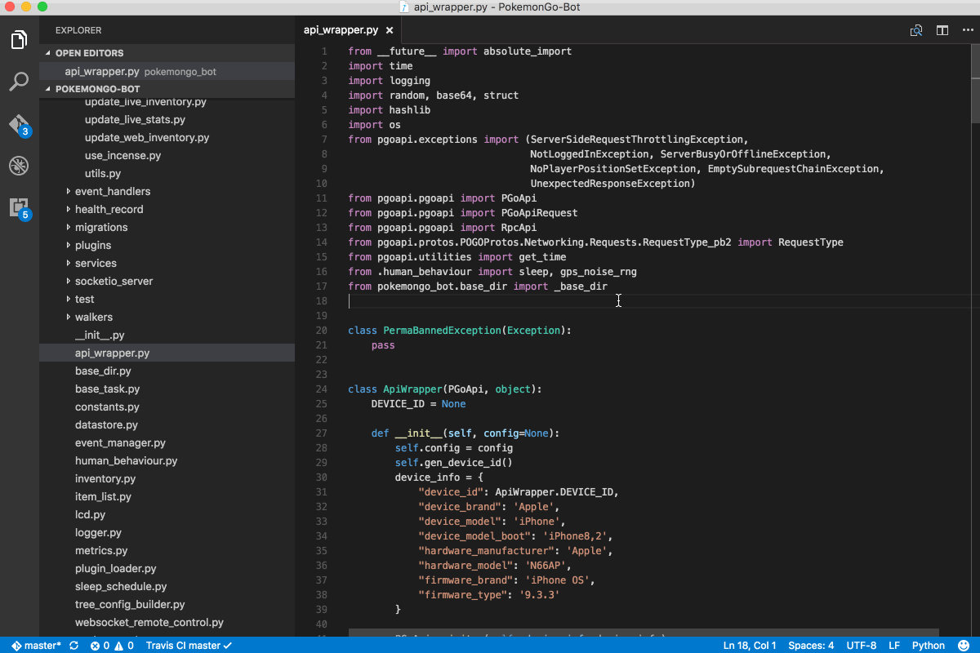
Initial Tunings
Shared OAuth Token Creation URL
Created a pattern which utilizes the shared-credentials option for all OAuth Client-Credentials protected proxies, with a common Token Creation endpoint
Nginx Modifications
Persistent Connections
Socket Timeouts
Buffers
Worker Processes
TCP settings
SSL Settings
and more…
Notes:
J
WIKI COMMONS IMAGE https://upload.wikimedia.org/wikipedia/commons/6/6b/General6545.gif

Slide 10

Monitoring & Stability
High Availability Architecture
Ensure continuous operation
Robust Disaster Recovery
Quickly resume mission-critical functions following a disaster
Basic Monitoring and Alerting
Application Logging
Basic Telemetry
Host Monitoring
Availability Monitoring
… much more later on
Notes:
J
WIKI COMMONS IMAGE https://upload.wikimedia.org/wikipedia/commons/6/6b/General6545.gif
In addition to our performance tunings, we wanted to ensure we provided a stable platform for UHG’s traffic. So before running Kong in production, we first engineered a robust high availability and DR architecture, with – then, basic monitoring and alterting integrations.
Nowadays, thanks in part to the experience we’ve gained, Kong at Optum has integrations with at least 10 separate monitoring and alerting systems, which give us outstanding visibility into the solution and it’s integrations. This leads me nicely into (change slide)

Slide 11
Supporting Open Source
“How can we, as a large enterprise, have confidence in Open Source products?”
Notes:
R
When we announced that we had chosen to vet Kong, as our first candidate technology, we had a lot of questions from within the Company about supportability
What would we do in an emergency?
What if something didn’t work?
Effectively – “title” – . Today, we’re going to try and answer that question from our own experience.

Slide 12
Cultivate Internal Experts
1
Take the expertise from the Open Source community, and make it work for you
Notes:
R
And the first idea I’d like to bring up in this context is that of cultivating internal experts.
To get a sense for the value here, let’s think about how innovation happens. I happen to believe that innovation is a natural consequence of expertise + inspiration.
Inspiration is a bit tricky to pin down, so let’s narrow In on expertise and look at the source of expertise in both a closed-source and open-source model

Slide 13
Closed-Source Model
Experts are “rented”, and expertise is rendered only on specific requests
- Experts can only react, not innovate
Experts are unfamiliar with the specific environmental conditions
- Can significantly increase time to restoration, and reduce overall efficacy during troubleshooting; hampers innovation
Product is opaque, and your team’s understanding of it is limited
- Severely hampers internal innovation around the solution

Slide 14
Open-Source Model
Experts have the opportunity to leverage their skills for the benefit your entire space
- Experts can optimize integrations, support and ops because of this understanding
Experts are fully versed in the specific environmental conditions
- Can significantly decrease MTT, and maximize overall efficacy during troubleshooting
Product is entirely visible, and your team’s understanding of it is fully unhindered
- Enables cultivated experts to do full fledged solutioning

Slide 15
How do we cultivate Internal experts?
Notes:
R
Which brings me to our second idea -

Slide 16
Community Participation
2
Tried but True
Notes:
R
This gets thrown around so often it’s understandable to consider it in the same vein as somany overused memes, but truely embracing this idea is absolutely necessary to benefit from the virtuous cycle of open-source. There’s no 50/50 here. To do Open Source right, you need to jump in head first.

Slide 17

Any issues with Kong today?
No, why?
We just started to receive some HTTP 502s during our testing… and can’t find logs for the transactions
Notes:
R

Slide 18
Any issues with Kong today?
No, why?
We just started to receive some HTTP 502s during our testing… and can’t find logs for the transactions
Found the transaction in our STDOUT…
Notes:
R

Slide 19
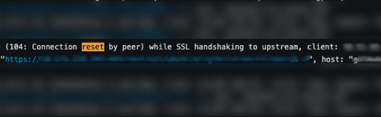
No, why?
We just started to receive some HTTP 502s during our testing… and can’t find logs for the transactions
Found the transaction in our STDOUT…
Notes:
R

Slide 20
Found the transaction in our STDOUT…
Looks like we got a connection reset on this transactions
Notes:
R

Slide 21
Found the transaction in our STDOUT…
Looks like we got a connection reset on this transactions
But that doesn’t explain why we’re missing a log even for this…
Notes:
R

Slide 22
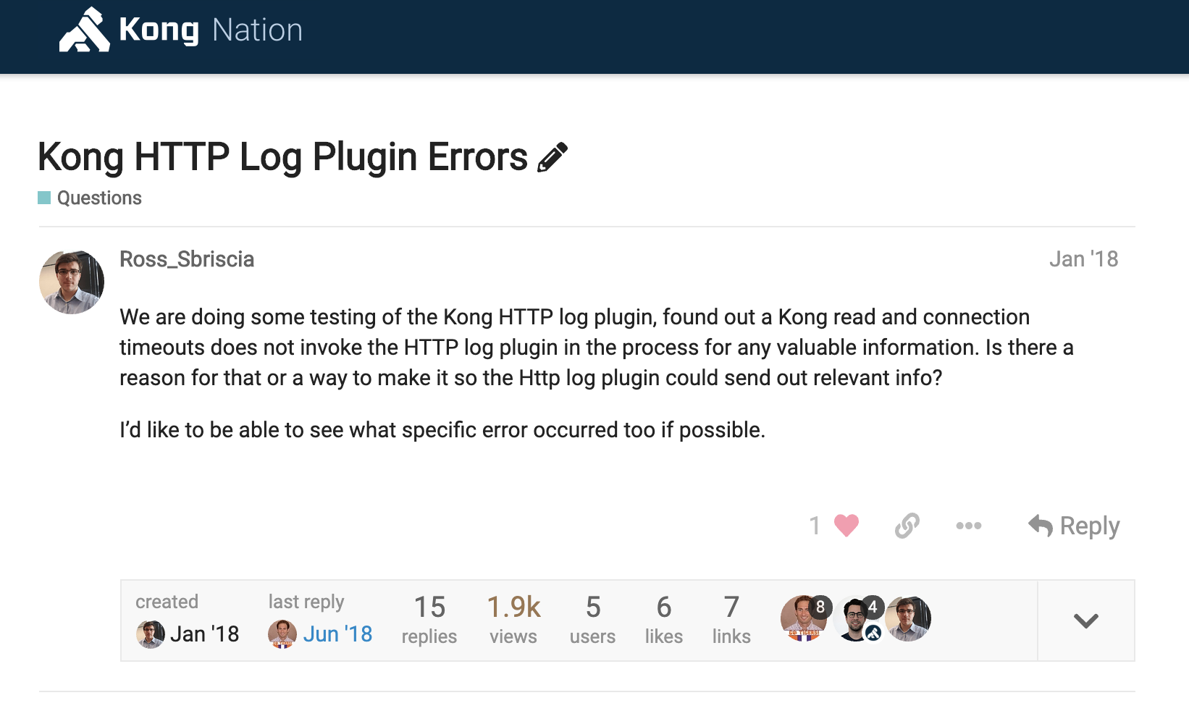
Notes:
R

Slide 23
On layer-4 errors, the Kong HTTP Log plugin doesn’t log transaction. Any idea why?
Try invoking the kong.log() method in the kong_error_handler block?
Notes:
R
https://discuss.konghq.com/t/kong-http-log-plugin-errors/445
https://discuss.konghq.com/t/kong-http-log-plugin-errors/445/3

Slide 24
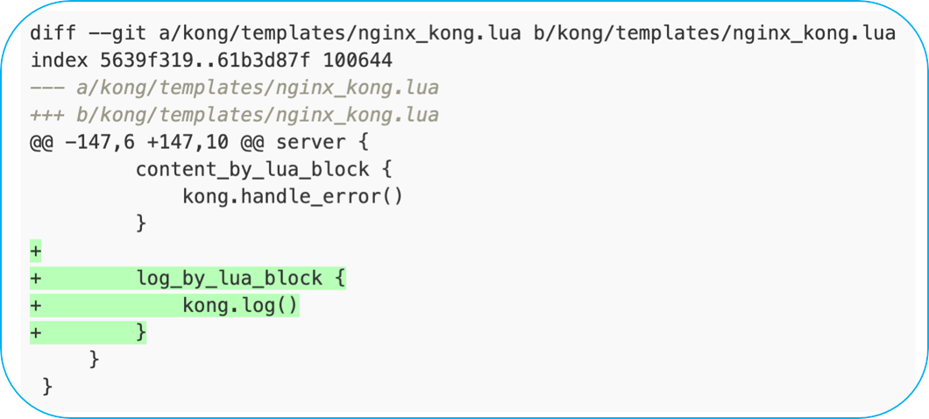
On layer-4 errors, the Kong HTTP Log plugin doesn’t log transaction. Any idea why?
Try invoking the kong.log() method in the kong_error_handler block?
Notes:
R
https://discuss.konghq.com/t/kong-http-log-plugin-errors/445
https://discuss.konghq.com/t/kong-http-log-plugin-errors/445/3

Slide 25
Notes:
R

Slide 26
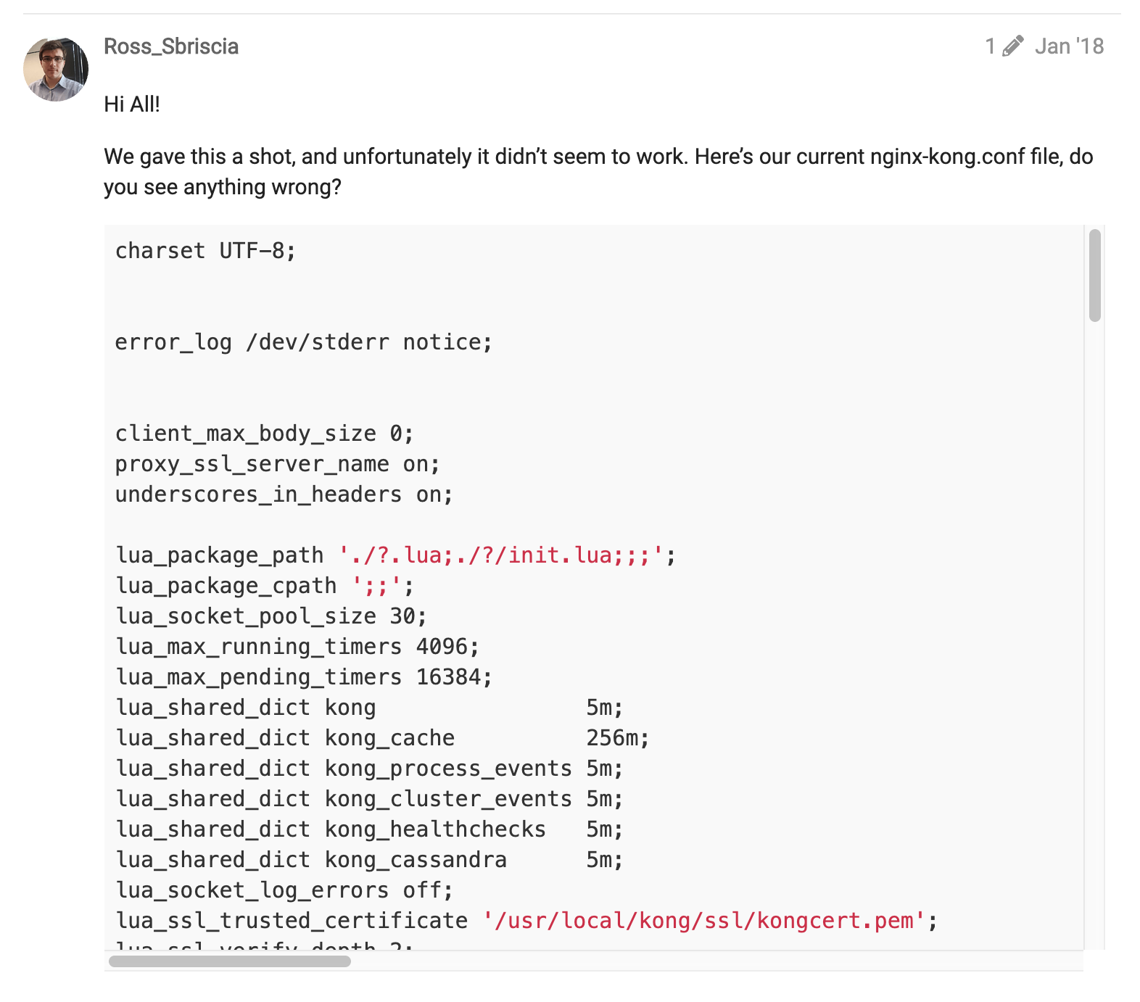
Notes:
R
https://discuss.konghq.com/t/kong-http-log-plugin-errors/445
https://discuss.konghq.com/t/kong-http-log-plugin-errors/445/3

Slide 27
On layer-4 errors, the Kong HTTP Log plugin doesn’t log transaction. Any idea why?
Try invoking the kong.log() method in the kong_error_handler block?
Didn’t work!
Notes:
R
https://discuss.konghq.com/t/kong-http-log-plugin-errors/445
https://discuss.konghq.com/t/kong-http-log-plugin-errors/445/3

Slide 28
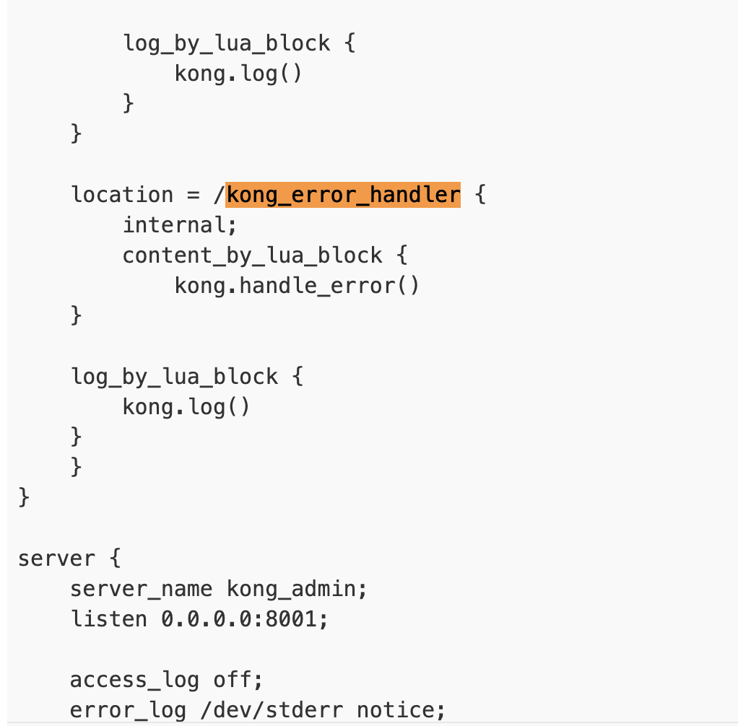
Try invoking the kong.log() method in the kong_error_handler block?
Didn’t work!
Notes:
R
https://discuss.konghq.com/t/kong-http-log-plugin-errors/445
https://discuss.konghq.com/t/kong-http-log-plugin-errors/445/3

Slide 29
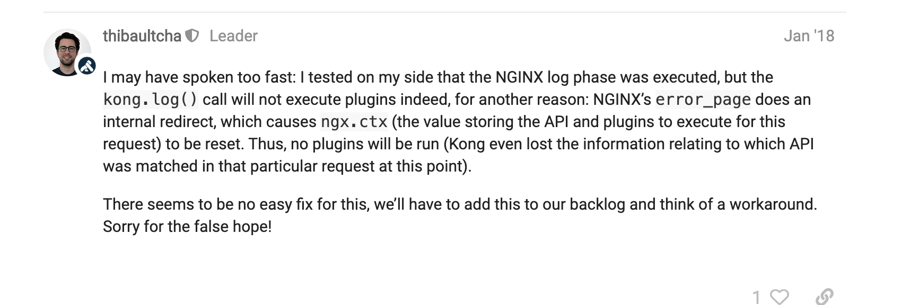
Notes:
R
https://discuss.konghq.com/t/kong-http-log-plugin-errors/445
https://discuss.konghq.com/t/kong-http-log-plugin-errors/445/3

Slide 30
Hmm…
Nginx’s error_page does an internal redirect which resets ngx.ctx… thus, no plugin will be run
Notes:
R
https://discuss.konghq.com/t/kong-http-log-plugin-errors/445
https://discuss.konghq.com/t/kong-http-log-plugin-errors/445/3

Slide 31

Hmm…
Nginx’s error_page does an internal redirect which resets ngx.ctx… thus, no plugin will be run
We’ll take a look
Notes:
R
https://discuss.konghq.com/t/kong-http-log-plugin-errors/445
https://discuss.konghq.com/t/kong-http-log-plugin-errors/445/3

Slide 32
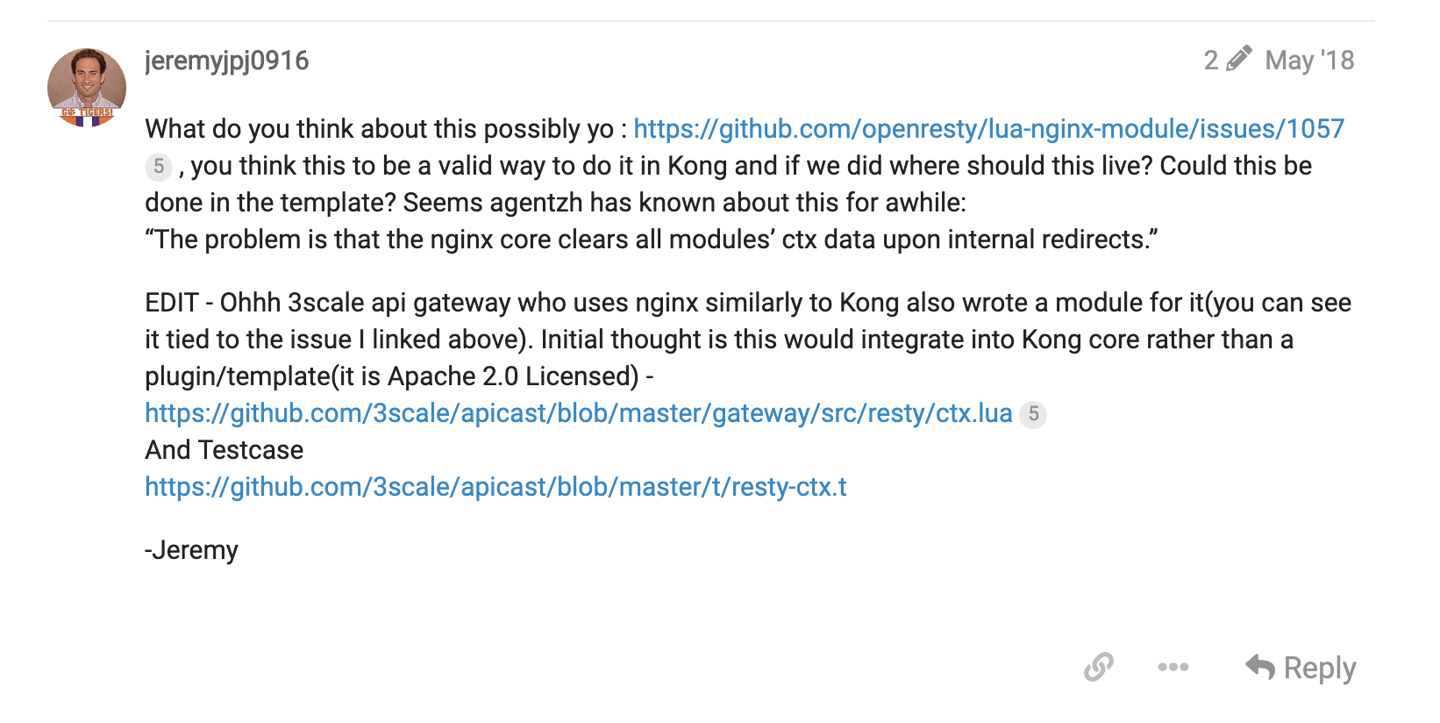
Notes:
R

Slide 33
Hmm…
Nginx’s error_page does an internal redirect which resets ngx.ctx… thus, no plugin will be run
We’ll take a look
We may have found something interesting in a similar Open-Source product.
Notes:
R
https://discuss.konghq.com/t/kong-http-log-plugin-errors/445
https://discuss.konghq.com/t/kong-http-log-plugin-errors/445/3

Slide 34
Hmm…
Nginx’s error_page does an internal redirect which resets ngx.ctx… thus, no plugin will be run
We’ll take a look
We may have found something interesting in a similar Open-Source product.
Looks like there’s a Library which may allow us to share the ngx.ctx between these subrequests. What do u think?
Notes:
R
https://discuss.konghq.com/t/kong-http-log-plugin-errors/445
https://discuss.konghq.com/t/kong-http-log-plugin-errors/445/3

Slide 35
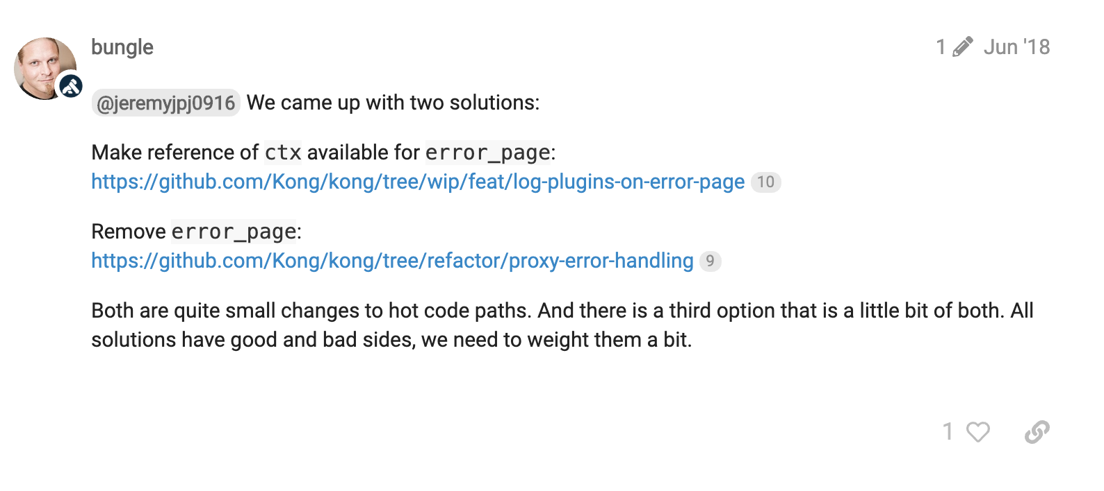
Notes:
R
https://discuss.konghq.com/t/kong-http-log-plugin-errors/445
https://discuss.konghq.com/t/kong-http-log-plugin-errors/445/3

Slide 36
We’ll take a look
We may have found something interesting in a similar Open-Source product.
Looks like there’s a Library which may allow us to share the ngx.ctx between these subrequests. What do u think?
We came up with some solutions. Each have positives and negatives
We need to weigh them internally, but all are small changes…
Notes:
R

Slide 37
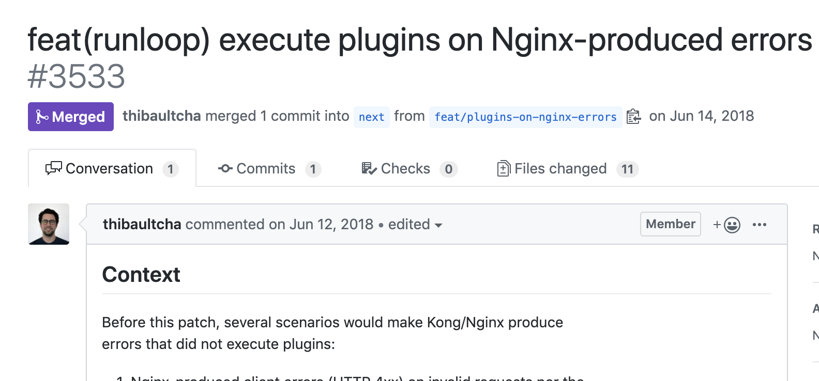
We’ll take a look
We may have found something interesting in a similar Open-Source product.
Looks like there’s a Library which may allow us to share the ngx.ctx between these subrequests. What do u think?
We came up with some solutions. Each have positives and negatives
We need to weigh them internally, but all are small changes…
Notes:
R

Slide 38
We’ll take a look
We may have found something interesting in a similar Open-Source product.
Looks like there’s a Library which may allow us to share the ngx.ctx between these subrequests. What do u think?
We came up with some solutions. Each have positives and negatives
We need to weigh them internally, but all are small changes…
Now closing this since #3533 has been merged - expect a 0.14.0rc1 in a few days. Thanks again!
Notes:
R

Slide 39
1. We had a problem
6. We attempted the solution
2. We investigated the problem
7. Re-engaged the community
3. Issue came back to Kong
8. We investigated the problem
4. We engaged the community
9. Suggested a solution
5. Community suggested a sol’n
10. Community confirmed sol’n
Looks like the ACL plugin includes a ever growing header containing all groups asociated to a consumer.
Notes:
J

Slide 40
1. We had a problem
6. We attempted the solution
2. We investigated the problem
7. Re-engaged the community
3. Issue came back to Kong
8. We investigated the problem
4. We engaged the community
9. Suggested a solution
5. Community suggested a sol’n
10. Community confirmed sol’n
Looks like the ACL plugin includes a ever growing header containing all groups asociated to a consumer.
Notes:
J
Now what I’d like to draw your attention to is the fact that this step occurs twice.
So, what exactly was it that changed between our first and second investigation such that the results differed so much?
Turns out, what changed for us, was the nature of the problem; it changed as a direct result of community participation, and feedback we received.

Slide 41
Contributing Back
3
Embracing the virtuous cycle of Open Source
Notes:
S

Slide 42
Any issues with Kong today?
No, why?
We just started to receive some HTTP 431s during our testing… not sure why?
Looks like the ACL plugin includes a ever growing header containing all groups asociated to a consumer.
Notes:
J

Slide 43
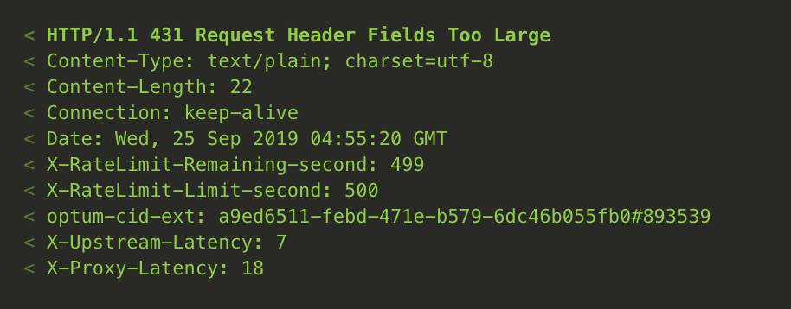
Any issues with Kong today?
No, why?
We just started to receive some HTTP 431s during our testing… not sure why?
Hmm.. Looks like HTTP Headers proxied are too big,
Let me look into which headers could be the culprit.
Looks like the ACL plugin includes a ever growing header containing all groups associated to a consumer.
Notes:
J

Slide 44
Any issues with Kong today?
No, why?
We just started to receive some HTTP 431s during our testing… not sure why?
Hmm.. Looks like HTTP Headers proxied are too big,
Let me look into which headers could be the culprit.
Looks like the ACL plugin includes a ever growing header containing all groups associated to a consumer.
Notes:
J

Slide 45
Any issues with Kong today?
No, why?
We just started to receive some HTTP 431s during our testing… not sure why?
Hmm.. Looks like HTTP Headers proxied are too big,
Let me look into which headers could be the culprit.
Looks like the ACL plugin includes a ever growing header containing all groups associated to a consumer.
Notes:
J

Slide 46
Any issues with Kong today?
No, why?
We just started to receive some HTTP 431s during our testing… not sure why?
Hmm.. Looks like HTTP Headers proxied are too big,
Let me look into which headers could be the culprit.
Looks like the ACL plugin includes a ever growing header containing all groups associated to a consumer.
Notes:
J

Slide 47
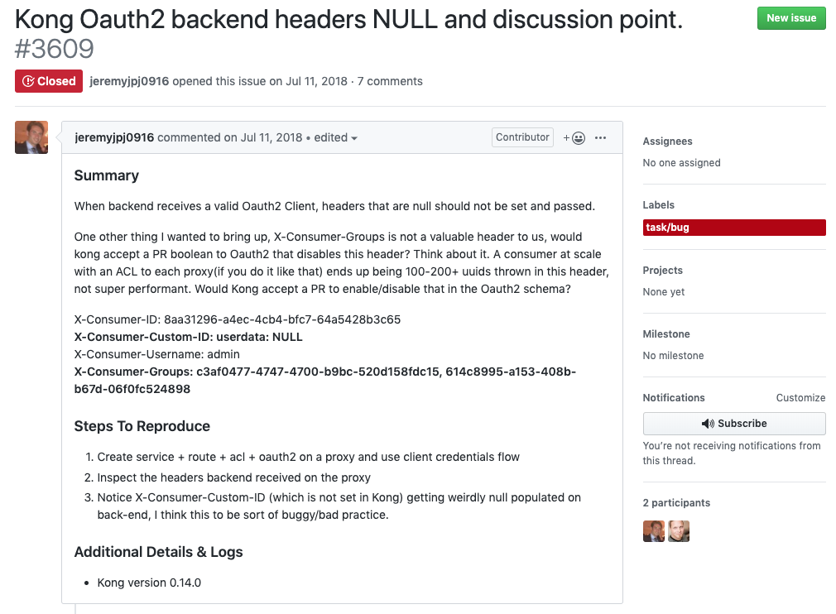
Notes:
J

Slide 48
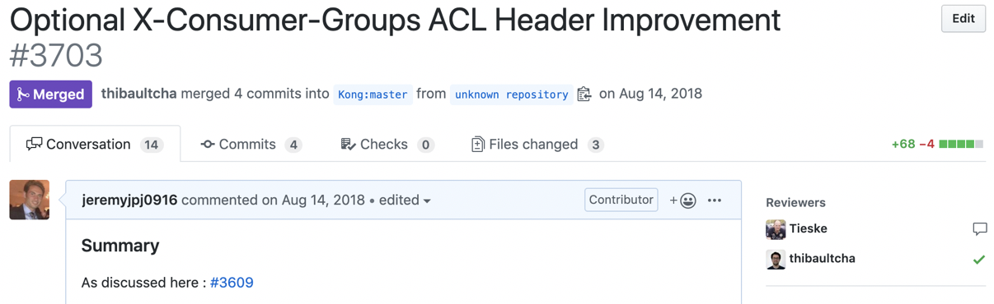
@jeremyjpj0916 I would give a + for such a PR on the ACL plugin.
I’ll try my hand at the code, thanks for the go ahead!
Notes:
J

Slide 49
@jeremyjpj0916 I would give a + for such a PR on the ACL plugin.
I’ll try my hand at the code, thanks for the go ahead!
Looks good!
Notes:
J

Slide 50
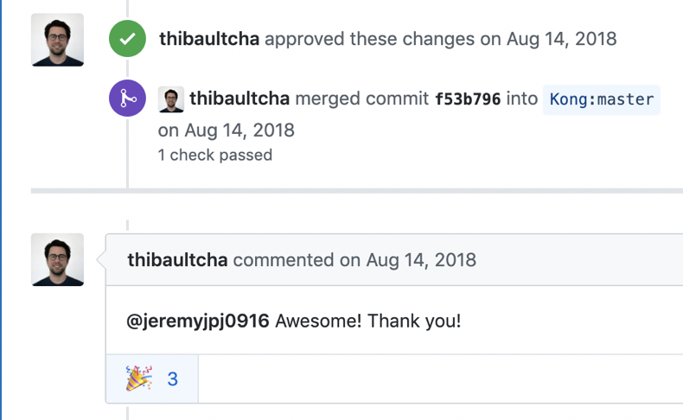
@jeremyjpj0916 I would give a + for such a PR on the ACL plugin.
I’ll try my hand at the code, thanks for the go ahead!
Looks good!
Notes:
J

Slide 51
Looks good!
We should also try setting a dummy-value in the cache, to reduce lua memory pressure
Try this
Notes:
J

Slide 52
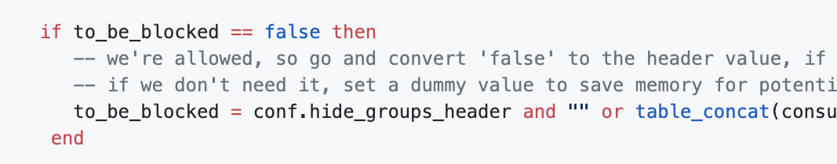
We should also try setting a dummy-value in the cache, to reduce lua memory pressure
Try this
Notes:
J

Slide 53
We should also try setting a dummy-value in the cache, to reduce lua memory pressure
Try this
Oh wow, great point I hadn’t considered that!
Let me iterate on this…
Notes:
J

Slide 54
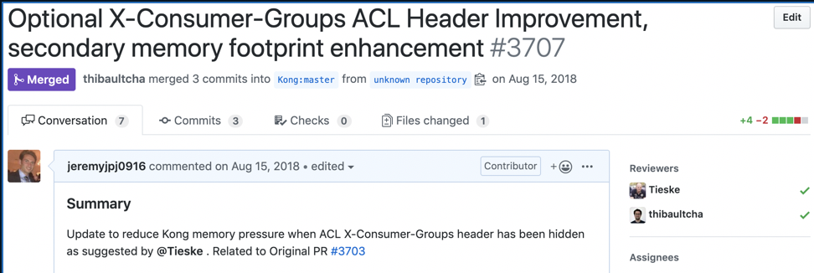
Notes:
J
Turnaround time? 2 PRs Merged Same Day Delivered.

Slide 55
Notes:
J
Turnaround time? 2 PRs Merged Same Day Delivered.

Slide 56
Offer a Product
4
Think of the technology and its integrations as a complete product
Notes:
S

Slide 57
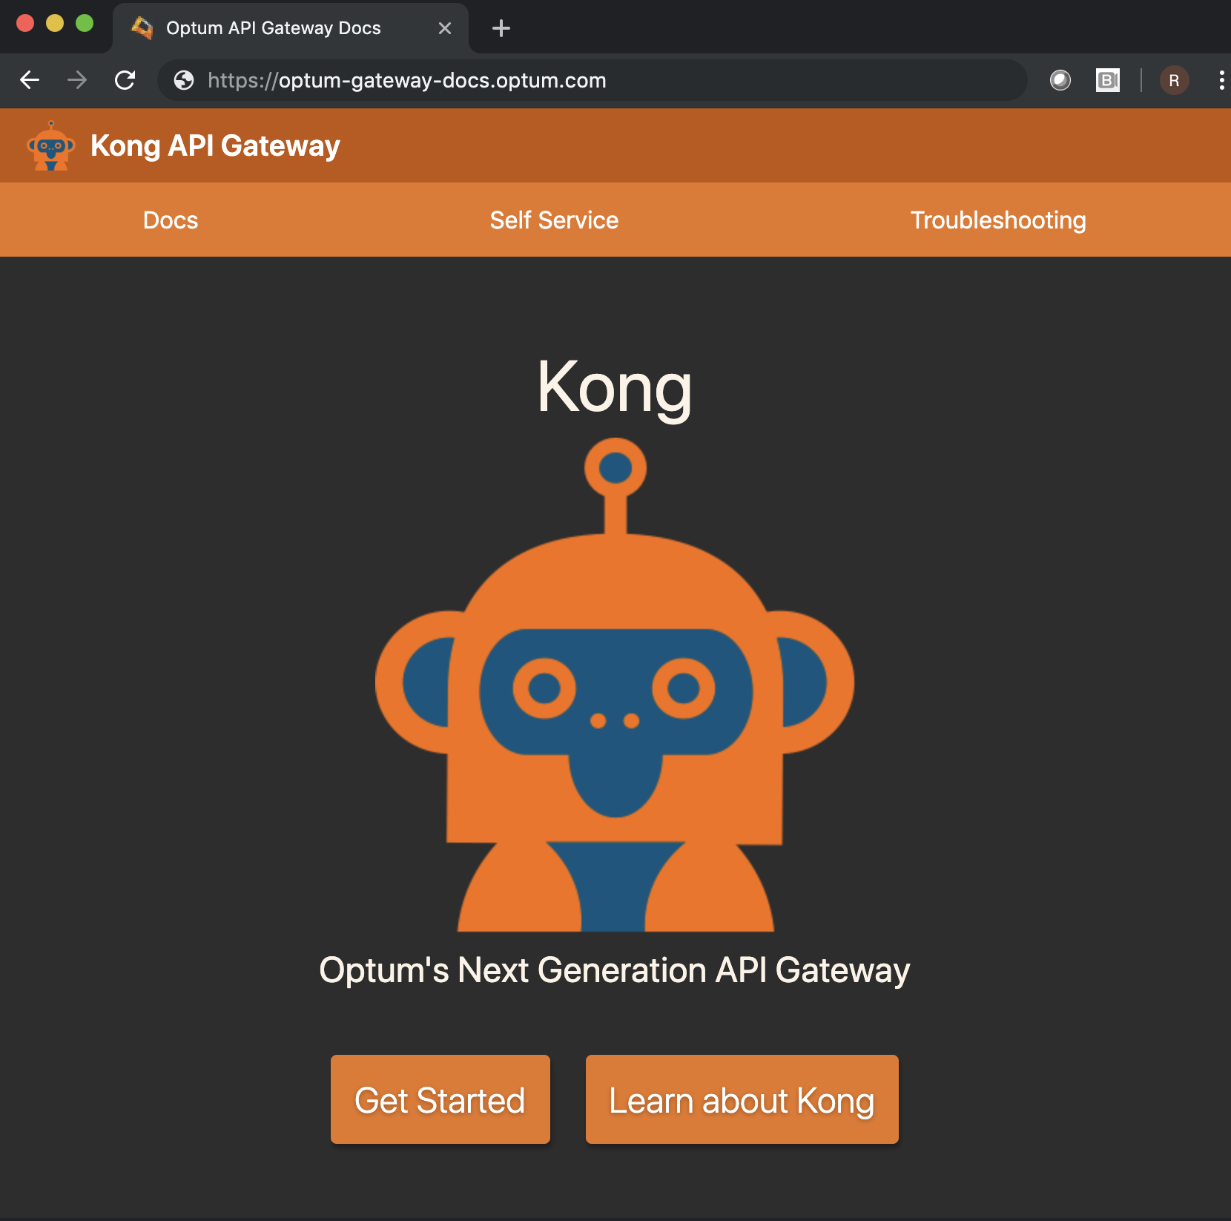
Docs First Approach
Lowers Operational Staffing Needs
Good documentation drastically reduces the need to meet & plan integrations, thus reducing the need for a large support team.
Good Engineering Culture
Providing environment-specific documentation provides your customers with the opportunity to innovate around your product, and enables DevOps!
Optum’s docs site contains 34 pages, covering everything
from supported security patterns, to self-service instructions.
Yes, we did give it an internal mascot ☺
Notes:
R

Slide 58
Operations Modernization
Email distribution list dialogs
Ticket work orders
Self-Service
Github ops model
Customer PRs to repo
Github Webhook calls to Agent
Agent integrates with Kong Admin API
Notes:
J
https://pixabay.com/illustrations/evolution-human-evolution-2780651/
https://pixabay.com/service/license/
Free for commercial use No attribution required

Slide 59
Self-Service Flow
Customer reads docs
Customer PRs to Github
Self-Service Bot Processes PRs
Bot Feedback to Customers on PRs
Customer PRs adjustments if necessary
Feedback Loop
Github Webhook
Call to Kong Admin API
Notes:
J
To answer that question, let’s skip forward to early 2018 and take a look at the first time Optum interacted with Kong (FIX WORDING)

Slide 60
Kong Resource Abstractions
Namespace
Service level owner email
Team distribution list email
Access Control
Internal ID
Namespace resource
Proxy resource
Requirements
{
"kind” : "gateway-namespace",
"action” : "create",
"spec” : {
"id” : "xxxxxxxx-xxxx-xxxx-xxxx-xxxxxxxxxxxx",
"namespace” : "kong.summit.consumer",
"sloEmail” : "my.email@example.com",
"teamEmailDL” : "my.team.dl@example.com",
"accessControl” : "REDACTED",
"internalID” : "REDACTED"
},
"metadata” : {
"tags” : [
"Kong Summit 2019",
"Example Tag"
]
}
}
Components
Notes:
J
To answer that question, let’s skip forward to early 2018 and take a look at the first time Optum interacted with Kong (FIX WORDING)

Slide 61
Results
5
Progress of our Ongoing Journey
Notes:
J

Slide 62
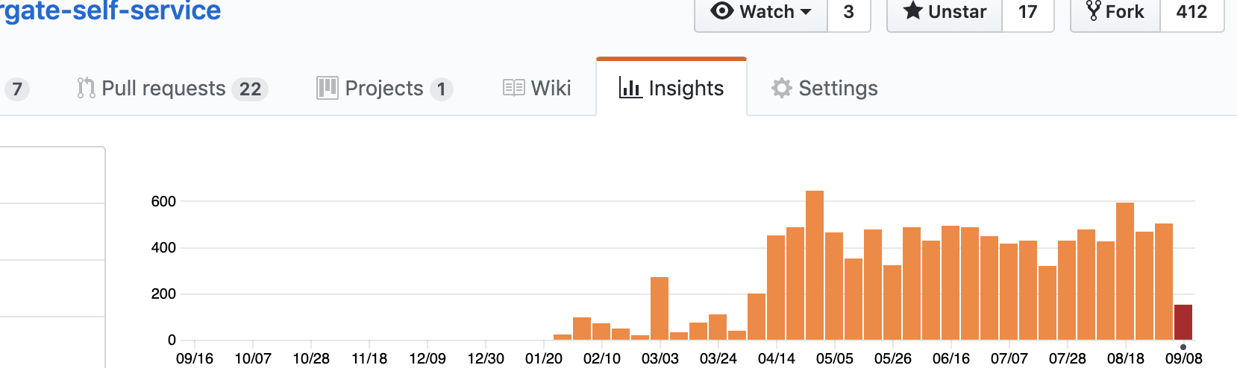
DevOps Self-Service Adoption
Features
Metrics
GitHub-Native Revision History
Automated Reporting/Alerting Integration
300+ Unique Users
2000 Operations/mo
Notes:
J
Prometheus/Grafana automated Integrations

Slide 63

Sense of Our Scale
~1900 APIs
~250 consumers
~375m API transactions
~7000 APIs
~1000 consumers
~4.2bn API transactions
*Monthly Active
Where we are
Where we’re going
Notes:
J
https://pixabay.com/illustrations/road-travel-journey-asphalt-4258554/
https://pixabay.com/service/license/
Free for commercial use No attribution required

Slide 64
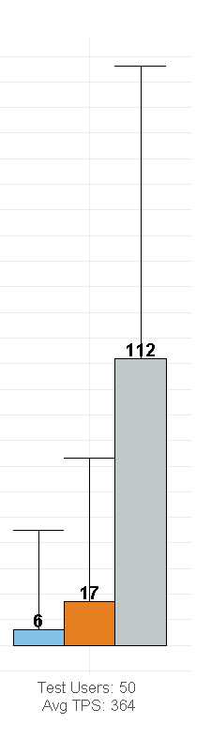
Comprehensive Improvements
Performance
85% reduction in GW overhead
90% increase in resource efficiency
Costs
Eliminate licensing costs
85% reduction in operations costs
95% overall cost reduction
Supportability
2 Engineers supporting 300k Employees
Extensible -> Custom use cases
Notes:
R
Let’s return to our original question [say subtitle], and see if; based on these and other experiences, we can come up with an answer.

Slide 65
The Question
“How can we, as a large enterprise, have confidence in Open Source products?”
Notes:
R
Let’s return to our original question [say subtitle], and see if; based on these and other experiences, we can come up with an answer.

Slide 66
Our Answer
Community Participation
Set the Stage
Share knowledge
Solve problems
Revisit existing integrations
Promote opensource culture
Offer a stable solution
Contribute Back
Direct community feedback
Community benefit
Cultivate Internal Experts
Enable innovation
Improve overall quality
Supportability
Offer a Product
Enable an engineering culture
Keep standards high
Notes:
First set the stage – promote a culture within your company which is supportive and curious about open source, and do your best to offer a stable product from the very start

Slide 67

Notes:
There is no Open Source without a Community.

